Slide 1
Advanced aerodynamic simulation of the Kelvin-Helmholtz instability over the Ahmed body using OpenFoam
Group Members:
Azamat Kabidollayev Supervisor: Prof. Michael Yong Zhao Saule Maulenkul Kaiyrbek Yerzhanov
Mechanical and Aerospace Engineering
Capstone Project Final Presentation
April 2021

Slide 2

Outline
Problem Statement
Aim and Objectives
Introduction
Literature Review
Methodology
Results
Conclusion

Slide 3
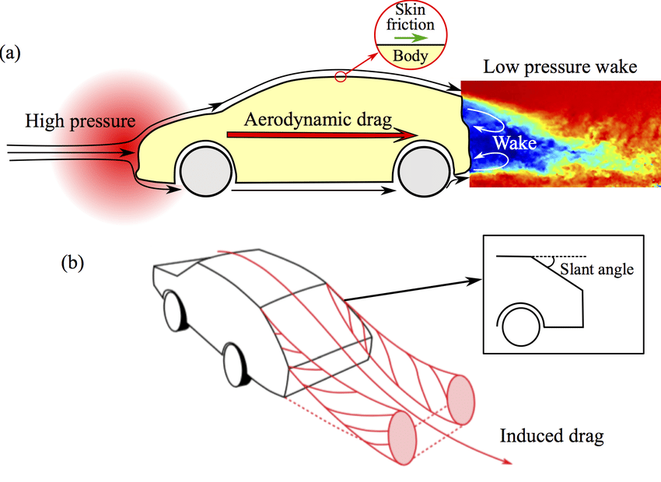
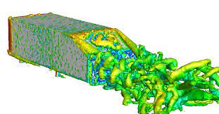
Problem Statement
Aerodynamics (drag coefficient)
Complexity of flow
(Li et al., 2017)

Slide 4
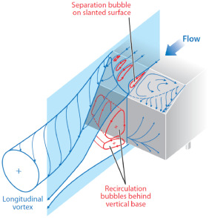
Objective
Project Aim
To perform Reynolds-Averaged Navier Stokes (RANS),Unsteady Reynolds-Averaged Navier Stokes (URANS), and Very Large Eddy Simulations (V-LES) in order to obtain drag coefficient over Ahmed Body and flow visualization behind the vehicle.
To capture counter rotating vortices, Kelvin-Helmholtz instability and separation of flow at the back(recirculation vortices) by implementing different turbulence models.
Predict the drag coefficient over Ahmed Body and compare it to experimental one.
Flow separation at the back (Li et al., 2017)

Slide 5

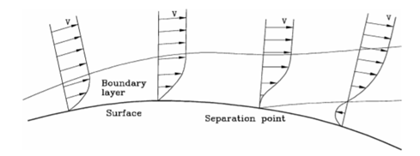
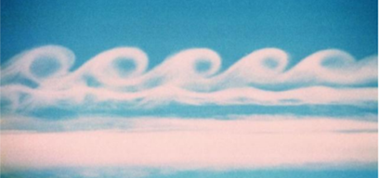
Introduction
Flow separation is the process which occurs because of lack of energetic flow and flow’s inability to move past sharp edges (Sivaraj et.al, 2018).
Kelvin-Helmholtz instability is free shear layer instability resulted due to the separation of boundary layer from the wall (Vujinovic, 2015).
Velocity distribution perpendicular to the surface with subsequent flow separation (Genta and Morello, 2009)
Kelvin-Helmholtz effect observed in the clouds (Vujinovic, 2015)

Slide 6
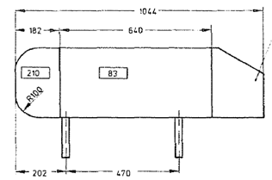
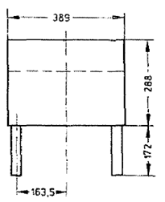
Introduction
Ahmed body is a simplified car shape which is used for aerodynamic study of cars.
Ahmed et al. (1984) described it as a model that consists of three parts, such as a fore body, mid-section, and rear end.
Ahmed body and its dimensions (Ahmed et al., 1984)

Slide 7
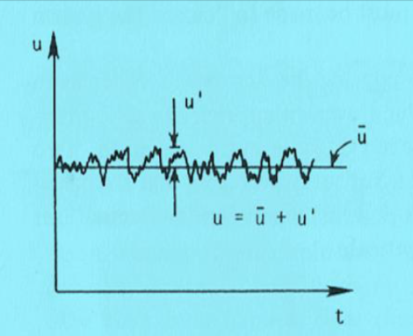
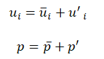
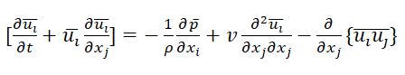
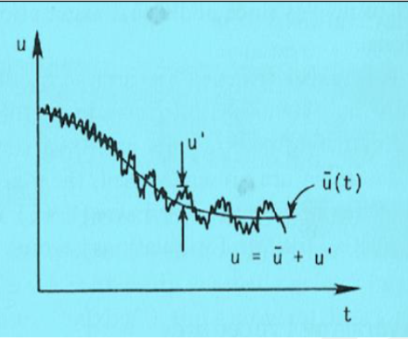
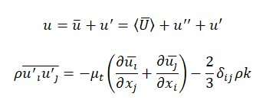
Introduction: Governing Equations
Reynolds-Averaged Navier Stokes (RANS)
Steady flow
Unsteady Reynolds-Averaged Navier Stokes (URANS)
Unsteady flow

Slide 8
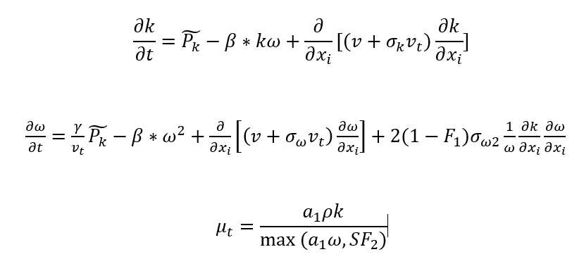
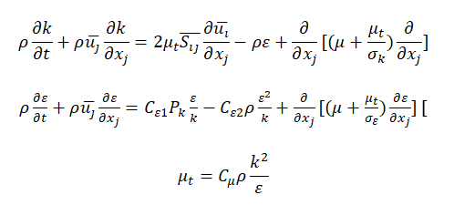
Introduction: Governing Equations
k-ω SST turbulence model
k-ε turbulence model

Slide 9
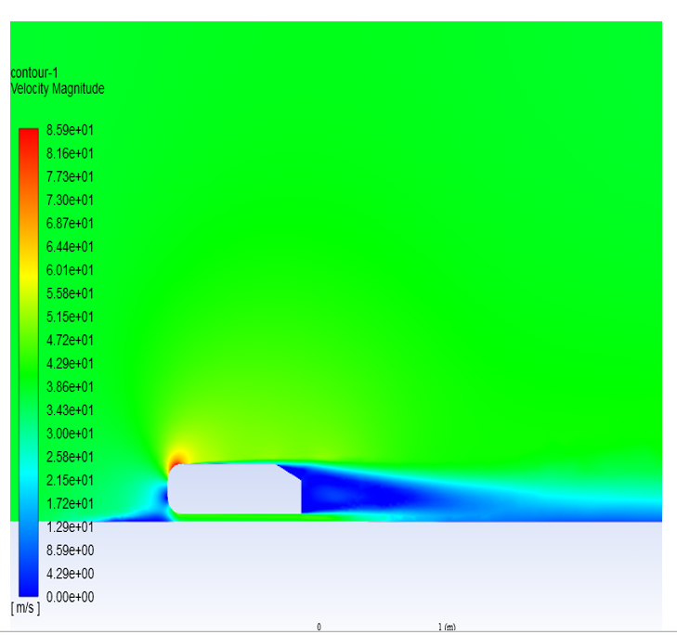
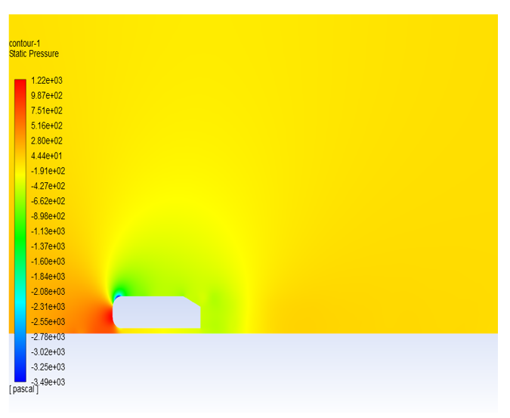
Literature Review: RANS
Velocity contours for RANS approach (Igali et al., 2019)
Pressure contours for RANS approach (Igali et al., 2019)
9

Slide 10
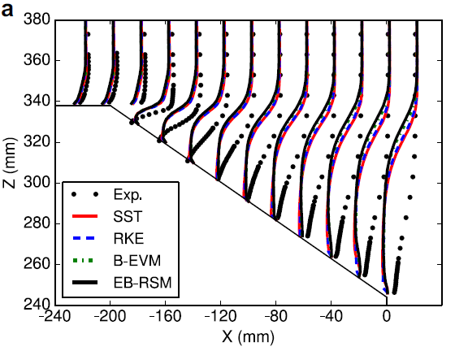
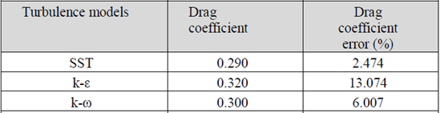
Literature Review: RANS
Results obtained by RANS approach and experimental data values (Igali et al., 2019)
Turbulence model | Drag Coefficient (Cd)
k-ω SST | 0.275
Experimental | 0.294
Velocity profile over Ahmed Body (Ashton et al.,2016)
Drag coefficient results (Ashton et al., 2016)

Slide 11
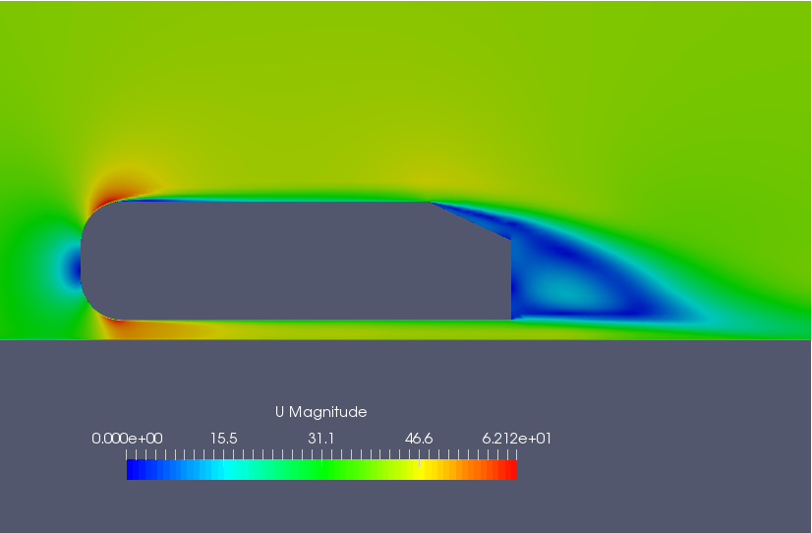
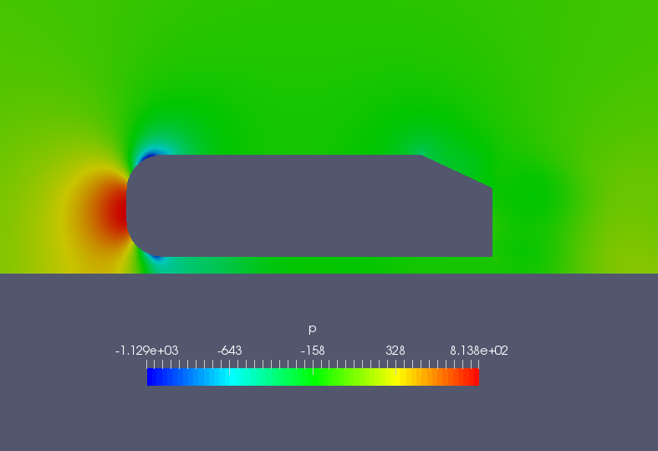
Literature Review: RANS
Turbulence model | Drag Coefficient (Cd)
k-ω SST | 0.365
Experimental | 0.299
Drag coefficient results (Aquillah et al., 2019)
Velocity contours for RANS k-ω SST approach (Aquilah et al., 2019)
Pressure contours for RANS k-ω SST approach (Aquilah et al., 2019)

Slide 12
Literature Review: URANS
Turbulence models | Drag coefficient | Drag coefficient error (%)
SST | 0.303 | 1.68
k-ε | 0.3156 | 5.91
k-ω | 0.335 | 12.4
Experimental Data (Ahmed et al., 1984) | 0.298 | NA
Comparison of drag coefficient values obtained by different turbulence models with experimental one (Sadykov et al, 2019)

Slide 13
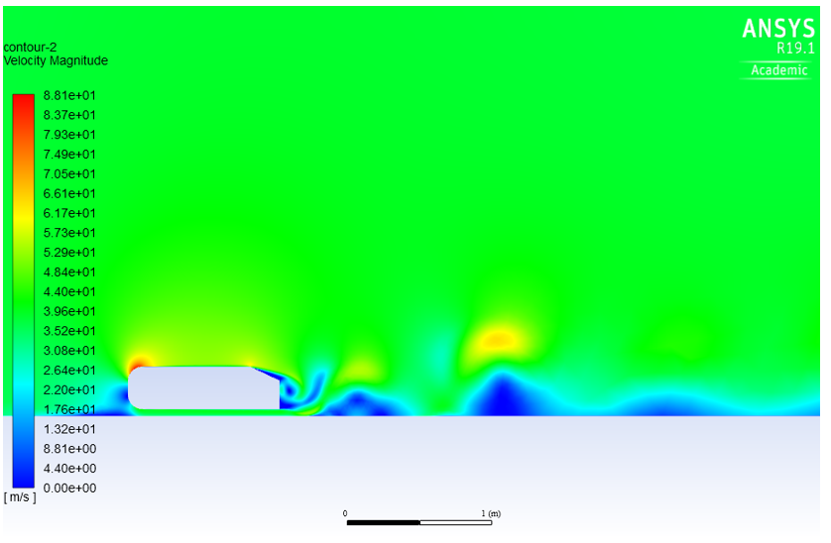
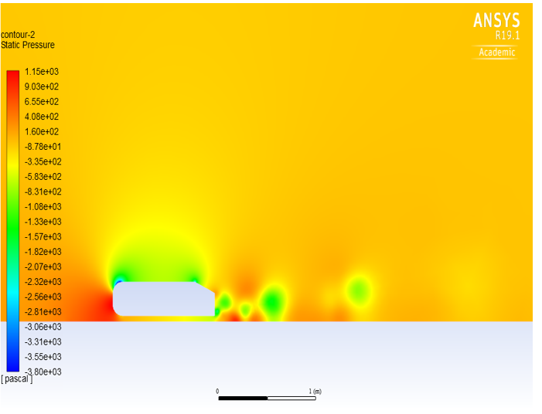
Literature Review: URANS
Velocity contours for URANS approach (Sadykov et al, 2019)
Pressure contours for URANS approach (Sadykov et al, 2019)

Slide 14
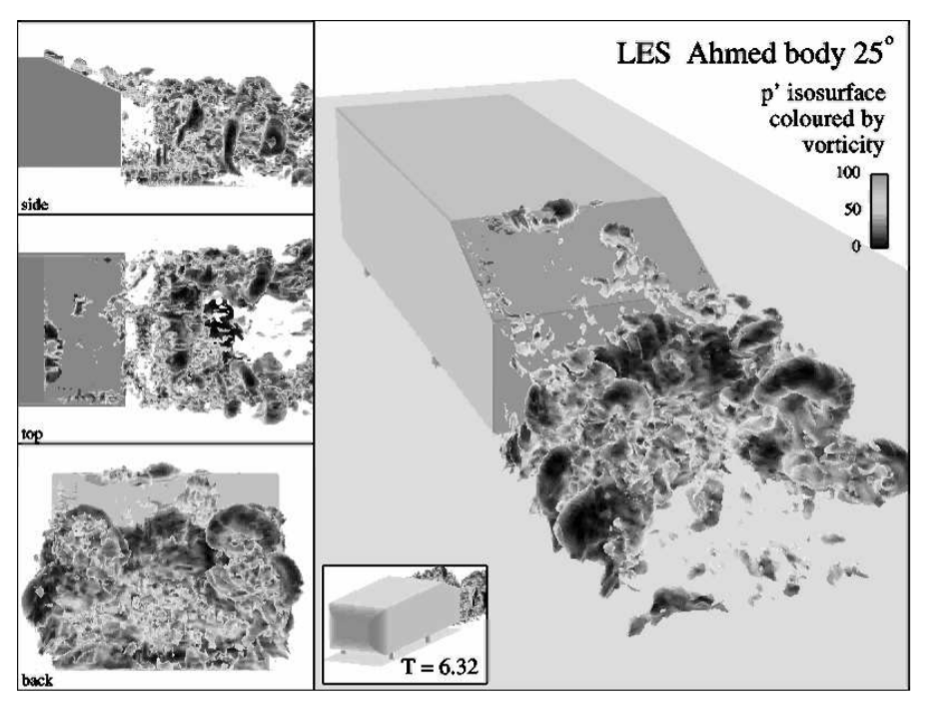
Literature Review: LES
It was proposed by Smagorinsky (1963) and large scale eddies are modeled directly by low pass filtering of Navier-Stokes Equations rather than averaging as in the RANS or URANS simulations(Serre et al,.2003).
Hinterberger et al.(2004) demonstrated that the accuracy of the solution is improved compared to RANS simulation. For example, drag coefficient was equal to 0.2979 for LES, whereas for RANS 0.4409.
Isosurface of pressure fluctuations (Hinterberger et al., 2004)
However,it needs high computation cost, which hinders the practical application of LES for high Reynolds number flow around Ahmed Body (Xia et al., 2020).

Slide 15
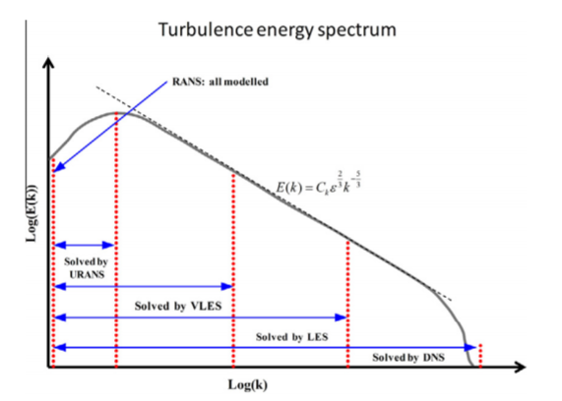
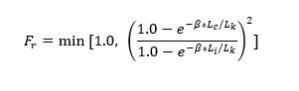
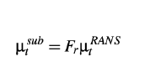
Literature Review: V-LES
V-LES combines RANS and LES:
numerical resolution in time and space only for the very large eddies
constitutes a turbulence approach with coarser grid requirements compared to LES (Han and Krajnović, 2013)
New Control function Fr(Johansen et al., 2004)
Turbulence energy spectrum and different modeling approaches from URANS to DNS (Argyropoulos and Markatos, 2015)

Slide 16
Methodology
OpenFOAM software
Boundary conditions
Mesh Generation
Mesh Convergence study
Solver setup in OpenFOAM

Slide 17

OpenFOAM software
OpenFOAM is a free CFD toolbox. It is used in academia and industry to solve wide variety of computational problems (OpenFoam.com, 2016).
OpenFoam simulation folder consists of:
0/: Initial conditions (U, P, omega, epsilon)
Constant/: Turbulent properties
System/: Simulation structure (control, mesh, solution, scheme dictionaries)
Notes:
Kaiyrbek 1:
First of all, the software platform to work with CFD simulation was chosen as OpenFOAM. The main advantage of this free and open software is its powerfulness to work with heavy simulations. Also, the simulation structure of OpenFOAM is assembled with 3 main folders: where 0, constant, and System files are located. 0 file consists of initial condition files (such as Velocity, Pressure, and turbulence models). Constant file is for Turbulence Properties. And the main, System file is responsible for simulation dictionaries.

Slide 18
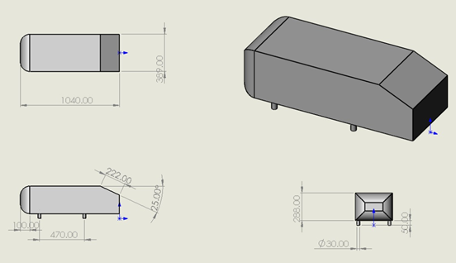
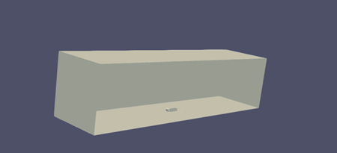
Boundary conditions
Inlet fluid velocity: 40 m/s (saved in 0 file )
Outlet: zero gradient velocity
The dimensions of the Ahmed body:
W (x-axis) = 389 mm
L (y-axis) = 1040 mm
H (z-axis) = 288 mm
The Fluid Properties based on the experimental conditions are saved 0 file:
Density (ρ) of fluid (air) at 25 ⁰C is 1.225 kg/m³.
Kinematic viscosity (υ) of fluid is 1.5*10⁻⁵ m²/s.
Reynolds number based on the height of Ahmed Body: 768000
Notes:
Kaiyrbek 1:
Next, to start the simulation procedure we need to know boundary conditions used in experimental study. The wind tunnel imitation was created in OpenFOAM, with given dimensions of Ahmed Body and wind tunnel 20 times larger in Y-axis. Also, Inlet fluid velocity of 40 m/s and fluid properties was calculated according to experimental case.

Slide 19
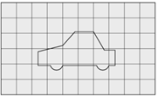
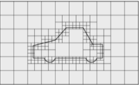
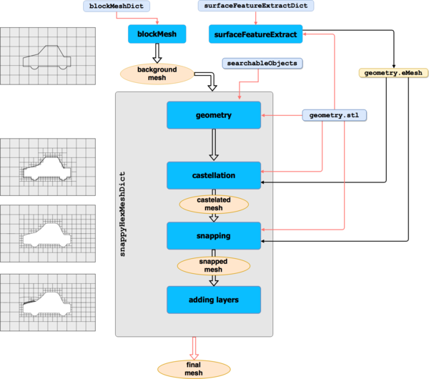
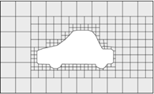
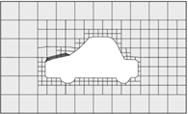
4 Steps of Mesh Generation
1.BlockMesh
2. Castellation
3. Snapping
4. Adding layers
The overview of meshing process (OpenFoam.com,2016)

Slide 20
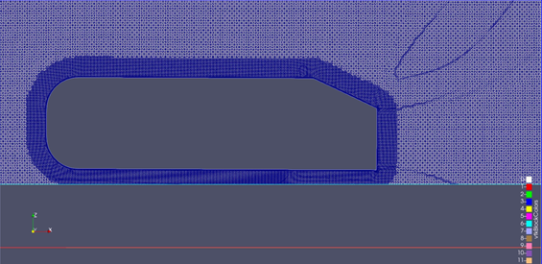
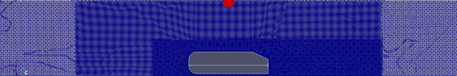
Mesh Generation
ahmed
{
mode distance;
levels ((0.05 4));
}
…refinementBox1
{
type searchableBox;
min (-3 -0.6 0);
max ( 3 0.6 1);
}…
Expansion layers around Ahmed Body
Refinement boxes over Ahmed Body

Slide 21
Mesh Convergence Study
Mesh # | Mesh Cell number | Dimension of blockMesh | Drag Coefficient | Difference %
1 | 1786575 | 0.14 | 0.40383256 | -
2 | 2608663 | 0.12 | 0.36932331 | 8.54%
3 | 4195405 | 0.1 | 0.35086109 | 4.53%
4 | 8070025 | 0.08 | 0.34506383 | 1.65%
A mesh convergence study was carried out before the relative variations of drag coefficient were less than 2%. It was done by RANS k-ω SST turbulence model.

Slide 22
Solver settings used in OpenFOAM
Time stepping (time discretization) | Steady State, Euler
Gradient Scheme( gradient term discretization) | cellLimited Gauss linear 0.5
Divergence Scheme (Convective terms) | LinearUpwind-2nd order
Laplacian Scheme (Diffusive terms) | Gauss linear limited 1
Linear Pressure equation Solver(symmetric matrix) | GAMG (generalised geometric-algebraic multi-grid)
Linear Velocity Equation Solver (asymmetric matrix) | PBiCG (Preconditioned bi-conjugate gradient)
Pressure-Velocity Coupling | SIMPLE, PIMPLE(PISO+SIMPLE)
Discretization of the solution domain or the mesh
Discretize in space each term of Navier-Stokes equations (diffusive, convective, gradient)
Discretize in time the obtained semi-discrete governing equations
Solve the linear system of discrete algebraic equations (crunch numbers)

Slide 23
Results and Discussion
RANS simulation results
URANS simulation results
V-LES simulation results
Verification of simulation results
Velocity profile over slant surface

Slide 24
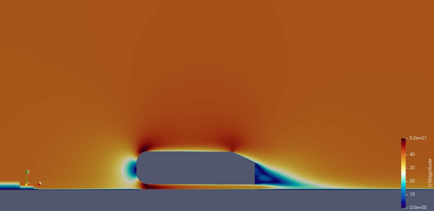
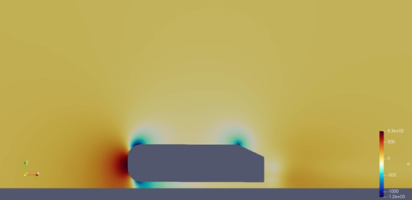
k-ε RANS simulation results
stagnation point
highest velocity values
highest pressure value
lowest velocity values
Velocity contours for RANS k-ε simulation
Pressure contours for RANS k- ε simulation

Slide 25
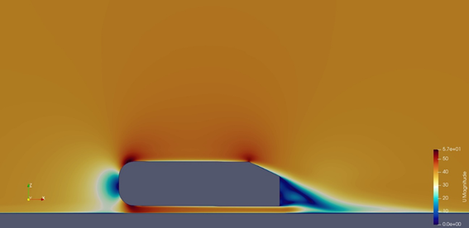
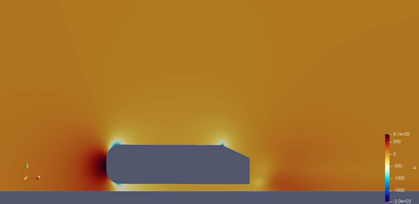
k-ω SST RANS simulation results
1.stagnation point (blue line)
2.Maximum value at the corners, which is 57 m/s
3. At the back of slant angle, smooth wake regions can be observed
2
1
3
Velocity Contours
Pressure Contours

Slide 26
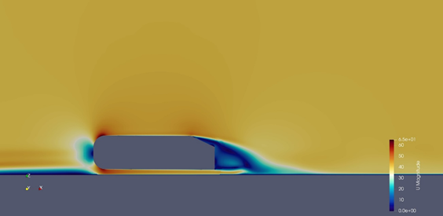
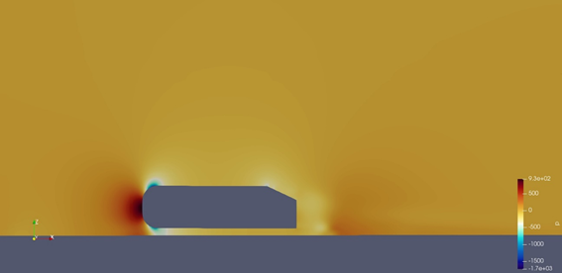
URANS k-ω SST simulation results
Velocity contours
Pressure contours
Velocity and Pressure contours for the last timesteps (stabilized).
Maximum velocity magnitude reaches 65 m/s.
URANS simulation can predict flow generation at different timesteps dependent on time.
k-ω SST models shows best solutions for flow prediction.
Notes:
Kaiyrbek 3:
As it was mentioned before, the dependency of URANS model on time was clearly described. Velocity and Pressure contours for the last timestep of simulation (where the fluid flow is stabilized) are illustrated in the figures. The maximum velocity value obtained in this simulation was 65 m/s, due to computational excellence over stable RANS simulations. The simulation with kOmegaSST model was described best for Unsteady simulations and for prediction of Cd.

Slide 27
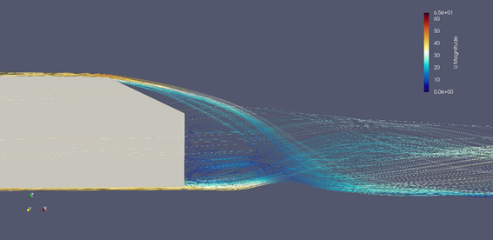
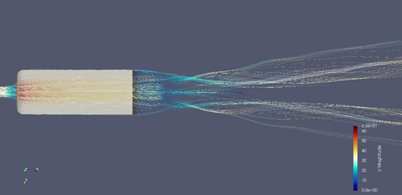
URANS k-ω SST (Velocity streamlines)
Velocity streamlines passing slant angle of the Ahmed Body:
Streamlines develop circulation zone at the back of the model (blue circulations)
Flow passing the slant angle generate two counter rotating trailing vortices.
Notes:
Kaiyrbek 4:
Talking about the slant angle velocity streamline at the back side of Ahmed Body, it is known that air flow passing through slant angle creates large eddy formations. Moreover, in the upper Figure, streamlines develop the circulation zone at the vertical wall of back side of the model, they are colored with cold blue color.
In the next figure, shown in top view the generation of two counter rotating symmetric trailing vortices are illustrated at the back. In this region, where the cold blue color predominantly occupies the lower Pressure magnitude is observed.

Slide 28
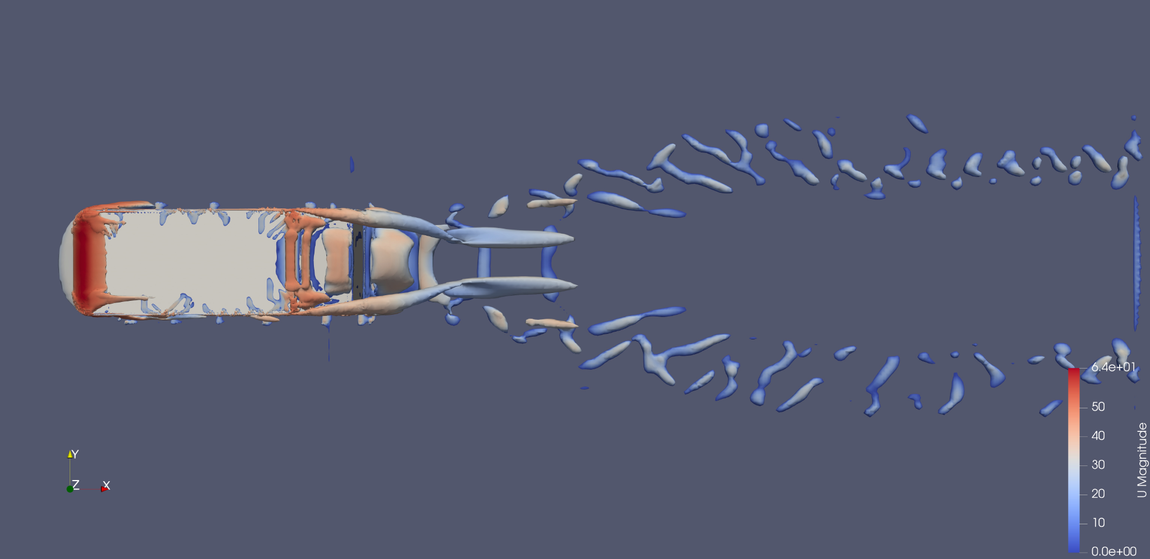
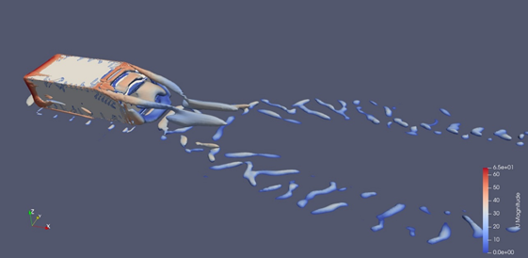
The development of vorticity around Ahmed body (URANS k-ω SST)
Visualization of vortices for every timestep differs significantly.
Counter rotating vortices with unstable prolongation for each rotating vortex.
No swirling component of vortexes seen.
Notes:
Kaiyrbek 5:
In this slide, the formation of vorticity is demonstrated in top and pictorial view. The figures captures last timestep results of vorticity contours over Ahmed Body. However, the formation of vortices differs significantly from one timestep to next. Therefore, the unstable prolongation for each counter rotating vortex is seen noticeably. In the next slide, we will see an animation demonstrating the formation of vortices showing the vortice tubes but without swirling component. The turbulent component of the vortices can’t be observed, due to averaging of results of URANS simulation.

Slide 29
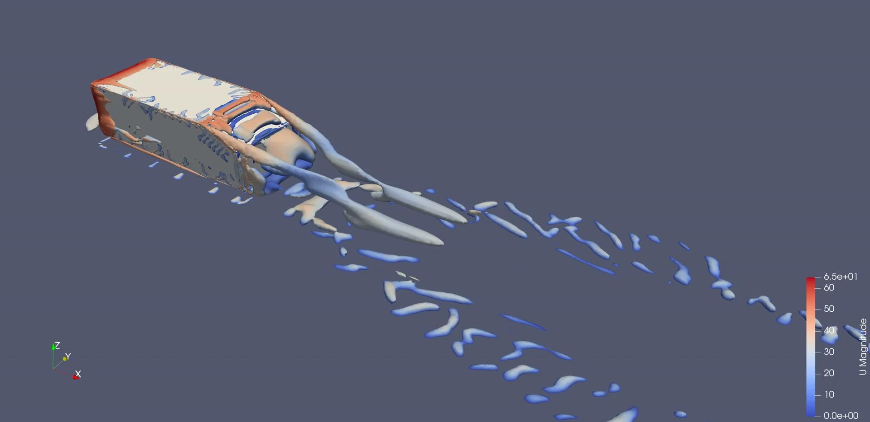
Animation of Vorticity contours of URANS simulation
Notes:
Kaiyrbek 5:
In the next slide, we will see an animation demonstrating the formation of vortices showing the vortice tubes but without swirling component. The turbulent component of the vortices can’t be observed, due to averaging of URANS simulation.

Slide 30
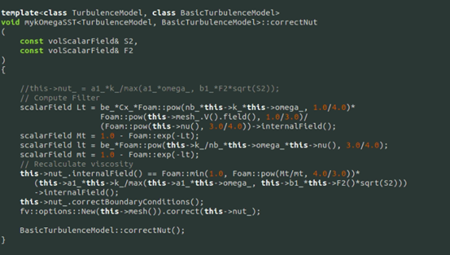
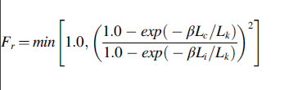
V-LES simulation source coding
The implementation of control function (Fr) equation into the source file of komegaSST.
Control function implementation into source files

Slide 31
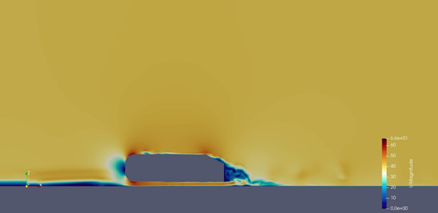
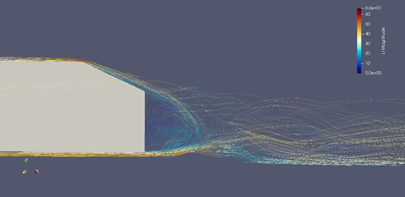

V-LES unsteady k-ω SST simulation results
Ability to capture unsteady the separation of shear layer at the slant angle and at the back as the Kelvin-Helmholtz instability effect, which can be seen vividly in right top Figure at the interface of the blue and yellow regions.
recirculation zones at the rear end after slant angle surface
Notes:
The main difference of V-LES from the other two turbulence models is ability to capture unsteady the separation of shear layer at the slant angle and at the back as the Kelvin-Helmholtz instability effect, which can be seen vividly in right top Figure at the interface of the blue and yellow regions.

Slide 32



The development of vorticity around Ahmed body. (a) Top View. (b) Back side.
(a)
(b)
Experimental visualization

Slide 33

Animation of Vorticity development

Slide 34


Validation of Simulation Results
For validation purposes the average value of URANS and V-LES has been considered (0.329 VS 0.3127)

Slide 35
Comparison simulation results with experimental one
Turbulence models | RANS (k-ω SST) | URANS | V-LES
Drag coefficient | 0.345 | 0.329 | 0.3127
Experimental data(Ahmed et al.,1984) | 0.298 | 0.298 | 0.298
Error (%) | 14.8 | 10.4 | 4.93

Slide 36

Validation of velocity profile with experimental data
The best match is V-LES k-ω SST model.
Similarity RANS k-ω SST and k-ε models.
URANS shows fewer compatible result.
Simulation model results extend beyond the experimental results.
Notes:
Kaiyrbek 6:
Next PostProcessing results is observed in validation of velocity profile data with experimental ones.
In the Graph, Ahmed Body slant angle region is illustrated with velocity profiles for different simulation models. In addition to them, the experimental data (which is dotted line) is used for validation of simulation results.
The graph shows the agreement of all simulated velocity profile with experimental one. However, the best match is observed with the results of V-LES k-ω SST model. Also, the similarity of RANS k-ω SST and k-ε models was expected, but with k-ω SST model fitting closer with experimental results.
The notable point is seen in URANS simulation results, showing less compatible data with others. This could be explained by the fact traditional URANS are often insufficient to predict properly the detachment of the flow. There is an assumption of equilibrium turbulence which leads to an overestimate of the eddy viscosity.
Finally, in first two profiles, the experimental profile did not reach the surface of Ahmed Body completely. Hence the simulation model results extend beyond the experimental results.

Slide 37
Conclusion
V-LES model is the best turbulence approach among RANS and URANS:
Least drag coefficient difference (4.93%)
Ability of capturing counter rotating vortices, Kelvin-Helmholtz instability and separation of flow at the back.
Further improvements
Mesh Convergence study can be improved.
Notes:
Kaiyrbek 7:
As an outcome of this research it is recommended to improve the mesh convergence of the model, SnappyHexMesh parameters can be expanded by changing mesh structures, which will claim for additional computational resources.
This is the end of our presentation. If you have any questions, you can ask now.

Slide 38
Thank you for your attention

Slide 39
Content | Contributor
Abstract | Azamat Kabidollayev
Introduction | Azamat Kabidollayev, Saule Maulenkul
Governing Equations | Azamat Kabidollayev
Literature review | Azamat Kabidollayev, Saule Maulenkul
Methodology | Saule Maulenkul, Kaiyrbek Yerzhanov
Results and Discussion | Azamat Kabidollayev, Saule Maulenkul, Kaiyrbek Yerzhanov
Results of Y+ value around Ahmed Body | Saule Maulenkul
Mesh Convergence Study | Saule Maulenkul

Slide 40
RANS k-ε simulation results | Azamat Kabidollayev
RANS k-ω SST simulation results | Saule Maulenkul
URANS k-ω SST turbulence model results | Kaiyrbek Yerzhanov
VLES steady k-ω SST turbulence model results | Saule Maulenkul
VLES unsteady k-ω SST turbulence model results | Saule Maulenkul, Kaiyrbek Yerzhanov
Validation of simulation results with experimental data | Saule Maulenkul
Validation of velocity profile with experimental data | Kaiyrbek Yerzhanov
Conclusion | Kaiyrbek Yerzhanov

Slide 41
SIMPLE and PIMPLE algorithm setup in controldict File
application simpleFoam;
startFrom latestTime;
startTime 0;
stopAt endTime;
endTime 1000;
deltaT 1;
writeInterval 100;
writeFormat ascii;
application pimpleFoam;
startFrom latestTime;
startTime 0;
stopAt endTime;
endTime 1;
deltaT 0.0001
adjustTimeStep yes;
maxCo 1.0;
maxDeltaT 0.001

Slide 42

OpenFOAM structure (для себя)

Slide 43

Solver settings in OpenFOAM
Fvschemes file (Finite Volume Method)
General Transport Equation Navier-Stokes Equation Gauss Divergence Theorem Volume Integrals are become Surface Integrals Interpolation of Cell centered values to the face centers Midpoint rule of approximation(discretize) Time and space discretization Linear Iterative solver of simple algorithm (fvsolution file)
The main of Finite Volume Method has been achieved, by inverting PDE into algebraic equations, which can be solved by the linear-solvers.

Slide 44

Calculation of drag coefficient
forceCoeffs1
{
type forceCoeffs;
libs ("libforces.so");
patches (body);
magUInf 40;
rho rhoInf;
rhoInf 1.225;
dragDir (0 1 0);
lRef 1.04;
Aref 0.112;
Fluid domain and Ahmed Body

Slide 45

Vorticity visualization
Vorticity gives a measure of the rotation of the fluid and is defined as the curl of the velocity
Q-criteria is added to vorticity function, which indicates structures of turbulent flow. Q is the second invariant of the velocity gradient (▿u)
The vorticity and Q-criteria are sub-dictionary functions located in controlDict file as a Post-processing objects.
Notes:
Kaiyrbek 2:
The method of implementing Vorticity visualization over the Ahmed Body is shown in Figures. Vorticity measures the rotation of fluid flow and Q-criteria is added to the vorticity visualization as another resource for study such kind of flow structures. These two sud-directory functions are written in CONTROLDICT file as a Post-Processing objects.

Slide 46


SIMPLE and PIMPLE algorithm
RANS
URANS
V-LES
The representation of PIMPLE algorithm (OpenFOAM, 2016)
The representation of SIMPLE algorithm(WolfDynamics, 2019)

Slide 47


Slide 48


